Slide 1
Snowflake on GCP
Snowflake Concepts & Architecture
What is Snowflake
Snowflake is an analytic data warehouse provided as Software-as-a-Service (SaaS). Snowflake provides a data warehouse that is faster, easier to use, and far more flexible than traditional data warehouse offerings.
Data Warehouse as a Cloud Service
There is no hardware (virtual or physical) for you to select, install, configure, or manage.
There is no software for you to install, configure, or manage.
Ongoing maintenance, management, and tuning is handled by Snowflake
Snowflake runs completely on cloud infrastructure
Snowflake manages all aspects of software installation and updates.
SAAS – Software as a service
Snowflake cannot be run on private cloud infrastructures (on-premises or hosted)
Snowflake is not a packaged software offering that can be installed by a user. Snowflake manages all aspects of software installation and updates

Slide 2
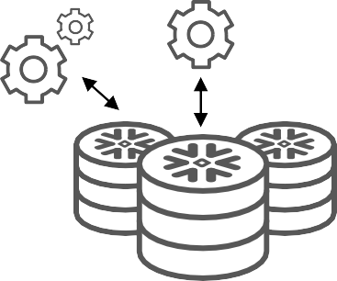


Snowflake Architecture
Snowflake Concepts & Architecture
Traditional Architectures
Snowflake
Multi-cluster, shared data
Centralized, scale-out storage Multiple, independent compute clusters
Shared-disk Shared storage Single cluster
Shared-nothing Decentralized, local storage Single cluster
25

Slide 3
Snowflake on GCP
Snowflake Concepts & Architecture
Snowflake Architecture
Snowflake’s architecture is a hybrid of traditional shared-disk database architectures and shared-nothing database architectures.
Similar to shared-disk architectures, Snowflake uses a central data repository for persisted data that is accessible from all compute nodes in the data warehouse
Similar to shared-nothing architectures, Snowflake processes queries using MPP (massively parallel processing) compute clusters where each node in the cluster stores a portion of the entire data set locally
This approach offers the data management simplicity of a shared-disk architecture, but with the performance and scale-out benefits of a shared-nothing architecture
Snowflake’s unique architecture consists of three key layers:
Database Storage
Query Processing
Cloud Services

Slide 4
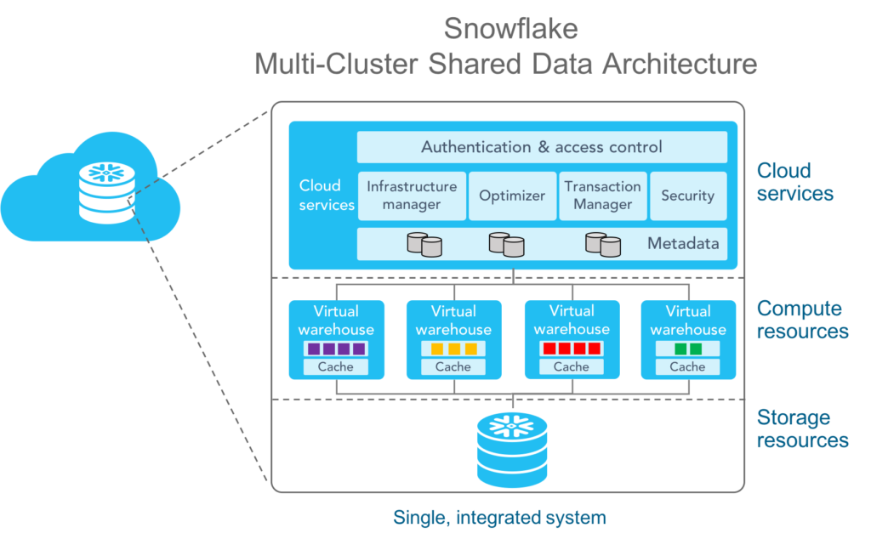
Snowflake Hybrid Architecture

Slide 5
Snowflake on GCP
Snowflake Architecture
Database Storage
Snowflake Data , loaded or stored reorganizes that data into its internal optimized, compressed, columnar format. Snowflake stores this optimized data in cloud storage.
The data objects stored by Snowflake are not directly visible nor accessible by customers; they are only accessible through SQL query operations run using Snowflake.
Query Processing
Snowflake processes queries using “virtual warehouses”. Each virtual warehouse is an MPP compute cluster composed of multiple compute nodes allocated by Snowflake from a cloud provider.
Each virtual warehouse is an independent compute cluster that does not share compute resources with other virtual warehouses
Cloud Services
The cloud services layer is a collection of services that coordinate activities across Snowflake
These services tie together all of the different components of Snowflake in order to process user requests, from login to query dispatch
The cloud services layer also runs on compute instances provisioned by Snowflake from the cloud provider

Slide 6
Snowflake on GCP
Snowflake Architecture
Cloud Services
Among the services in this layer:
Authentication
Infrastructure management
Metadata management
Query parsing and optimization
Access control
Connecting to Snowflake
Web UI – Web Interface
CLI – SnowSQL – Command Line Utility
ODBC – JDBC
Native Connectors – Java, Python
Third Party Connectors – ETL Tools – Informatica, Talend, Matallion

Slide 7
Snowflake on GCP
Snowflake Architecture
Differences Between Regions
Snowflake features and services are identical across regions except for some newly-introduced features (based on cloud platform or region). However, there are some differences in unit costs for credits and data storage between regions.
Another factor that impacts unit costs is whether your Snowflake account is On Demand or Capacity.
Considerations for Choosing a Region for Your Account
When you request a Snowflake account, either through self-service or a Snowflake representative, you can choose the region where the account is located.
For example, you can decide to locate an account in a particular region on a particular cloud platform to address latency concerns and/or provide additional backup and disaster recovery beyond the standard recovery support provided by Snowflake. Snowflake does not place any restrictions on the region where you choose to locate each account.
If latency is a concern, you should choose the available region with the closest geographic proximity to your end users; however, this may have cost implications, due to pricing differences between the regions
If you are a government agency or a commercial organization that must comply with specific privacy and security requirements of the US government, you can choose between two dedicated government regions provided by Snowflake.
Regions do not limit user access to Snowflake; they only dictate the geographic location where data is stored and compute resources are provisioned.
In addition, Snowflake does not move data between accounts, so any data in an account in a region remains in the region unless users explicitly choose to copy, move, or replicate the data.

Slide 8
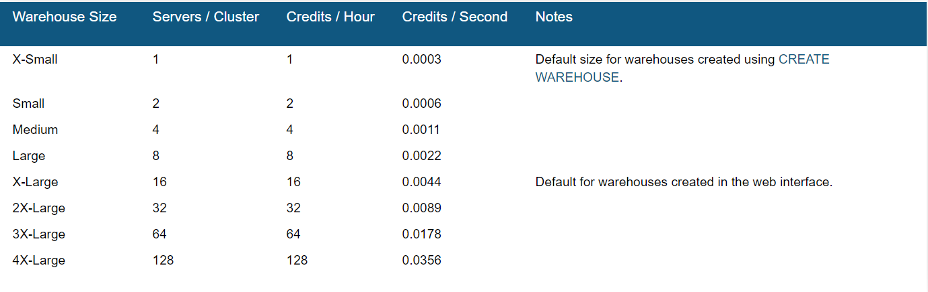
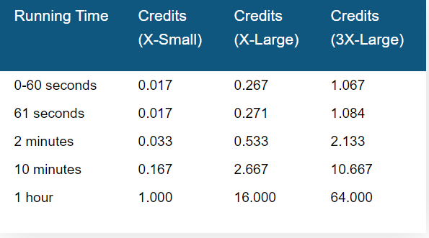
Virtual Warehouse Sizes

Slide 9
Snowflake on GCP
Snowflake Platforms & Pricing
Supported Cloud Platforms
AWS
Azure
GCP
Each platform provides one or more regions where the account is provisioned
The cloud platform you choose for each Snowflake account is completely independent from your other Snowflake accounts
Pricing
Differences in unit costs for credits and data storage are calculated by region and cloud platform
Pricing Page : pricing page

Slide 10
Snowflake on GCP
Snowflake Data Loading & Naming
Data Loading
Snowflake supports loading data from files staged in any of the following locations, regardless of the cloud platform for your Snowflake account:
Internal (i.e. Snowflake) stages
Amazon S3
Google Cloud Storage
Microsoft Azure blob storage
Snowflake supports both bulk data loading and continuous data loading (Snowpipe)
Snowflake supports unloading data from tables into any of the above staging locations.
Specifying Region Information in Your Account Hostname
A hostname for a Snowflake account starts with an account name (provided by Snowflake) and ends with the Snowflake domain
<account_name>.snowflakecomputing.com

Slide 11
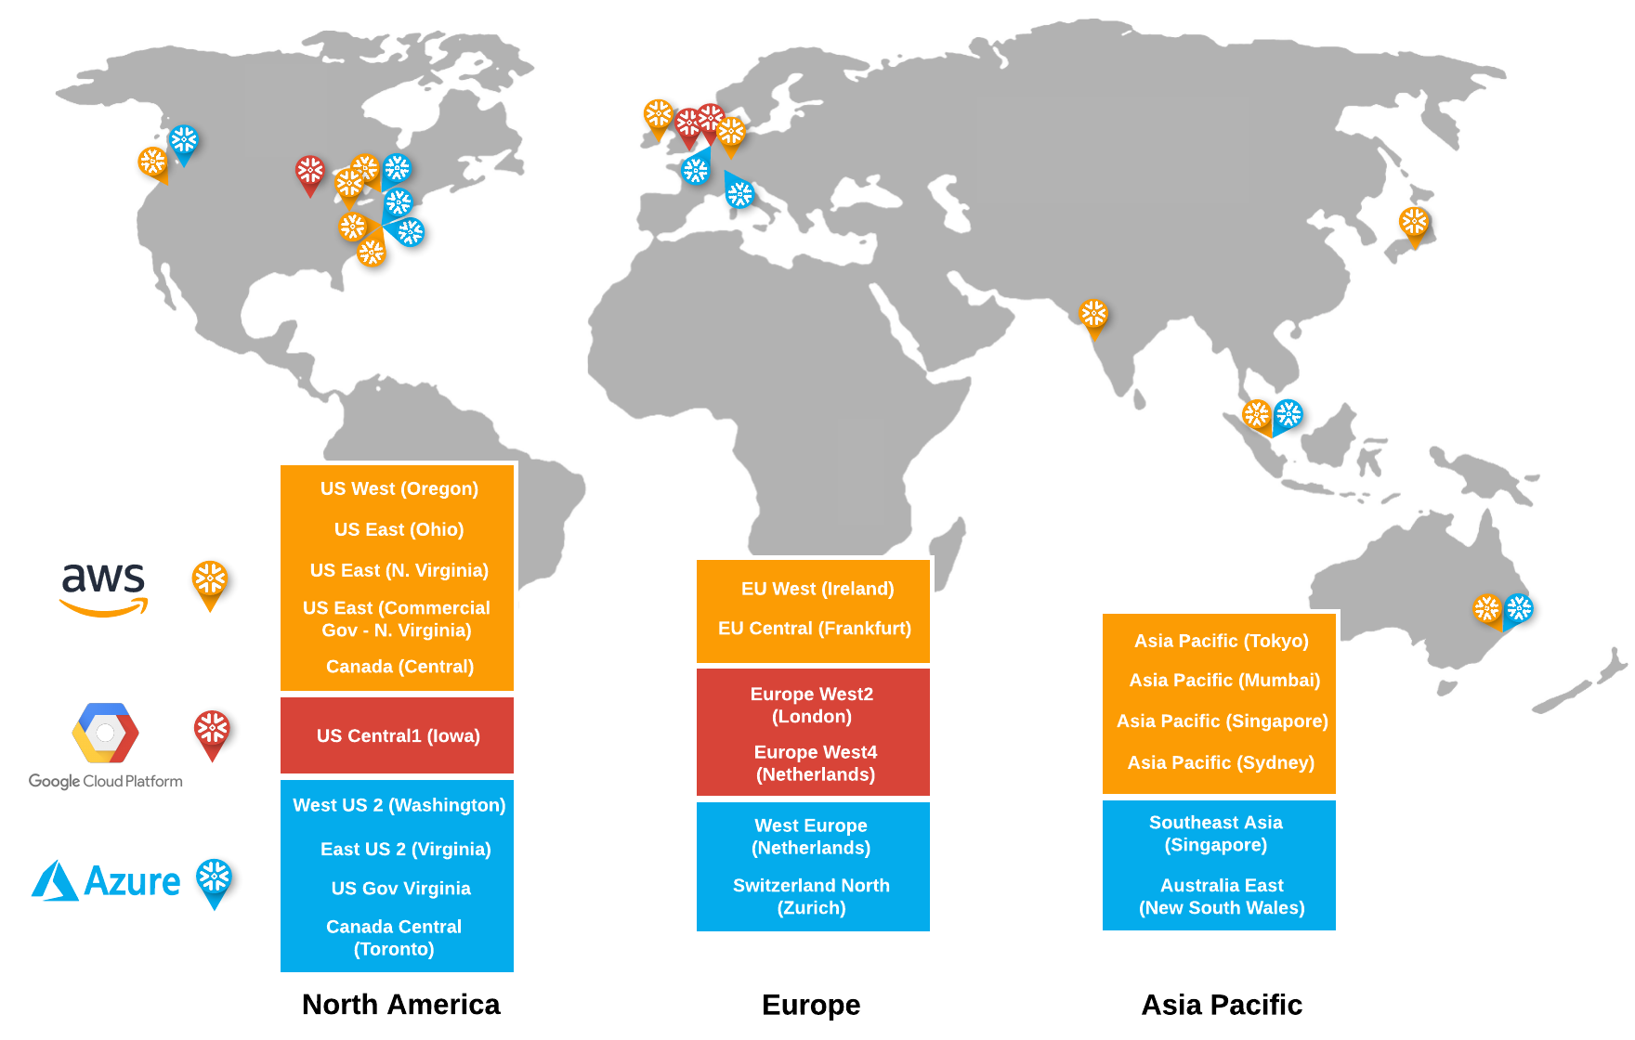
Snowflake on GCP
Snowflake Regions
Snowflake Regions

Slide 12
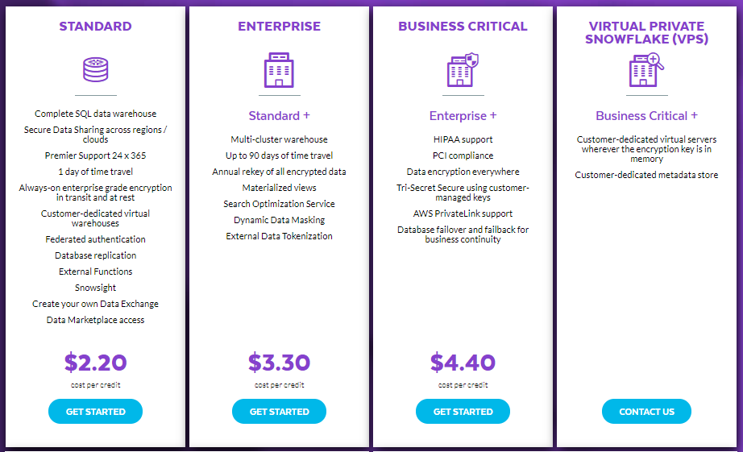
Snowflake Editions

Slide 13
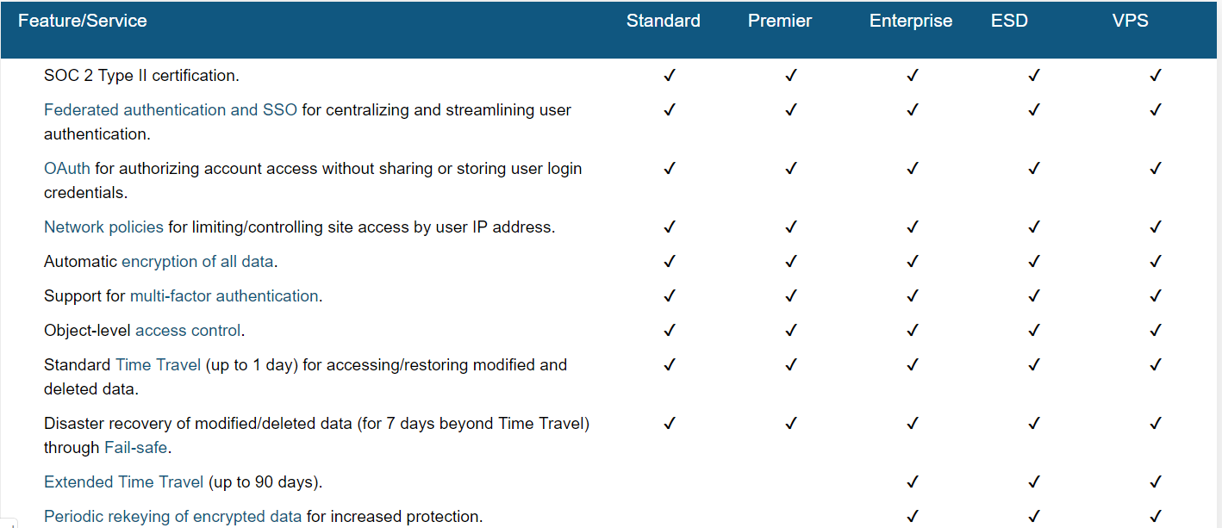
Snowflake Editions Comparison

Slide 14
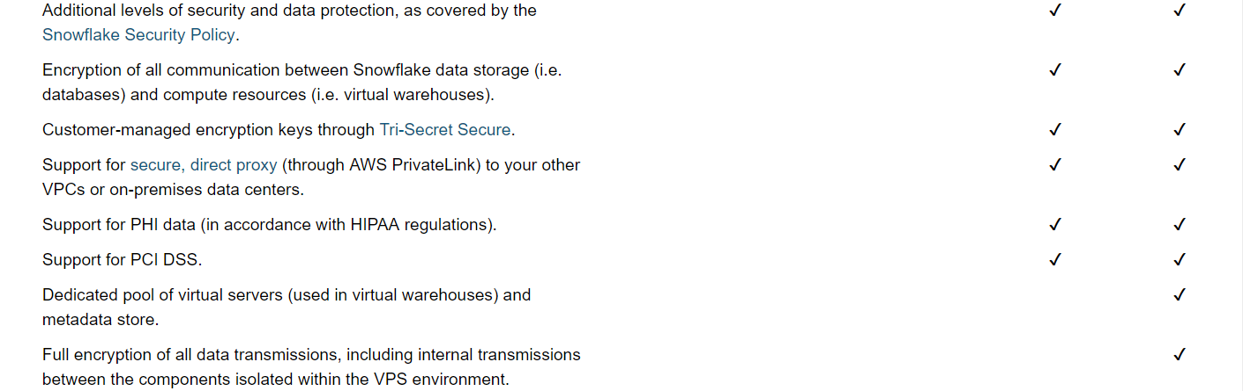
Snowflake Editions Comparison

Slide 15
Snowflake on GCP
Snowflake Release Management
Snowflake Releases
Snowflake new releases and patch releases each week in the form of new features, enhancements, and fixes
The deployments happen transparently in the background
Users experience no downtime or disruption of service, and are always assured of running on the most-recent release with access to the latest features
Release Types
New Releases
Patch Release
Pre-release Testing/Validation
Staged Release
Once a new release has been deployed, Snowflake does not move all accounts to the release at the same time
Accounts are moved to the release using a three stage approach over two days
This staged approach only applies to new releases. For patch releases, all accounts are moved to the patch release on the same day.
Day 1
Stage 1 (early access) for designated Enterprise accounts.
Day 1 or 2
Stage 2 (regular access) for all Standard Edition accounts.
Day 2
Stage 3 (final) for all Enterprise Edition and VPS accounts.

Slide 16
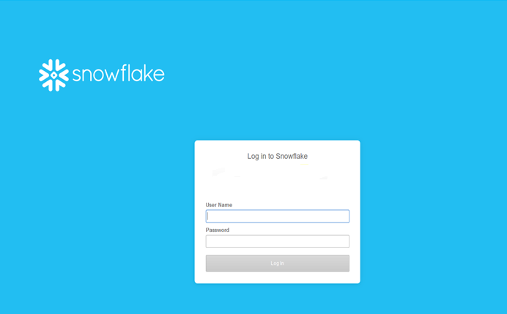
Snowflake on GCP
Snowflake WebUI
Logging into the Snowflake
Please enter / click on the Url that you have received in your email for the trial Snowflake Account you have requested
Log Into the Snowflake Account
Enter your User Name And Password

Slide 17
Snowflake on GCP
Snowflake WebUI
Snowflake web-based graphical interface, you can create and manage all Snowflake objects
Databases
Virtual Warehouses
All Database Objects (Schemas, Tables, Stages etc..)
Load Limited Amount of Data into Tables
Execute Queries , DDL and DML Operations
Based on the Role (Privileges) you have you can perform admin actions like Creating and Managing Users
Logging into the Snowflake
Please enter / click on the Url that you have received in your email for the trial Snowflake Account you have requested

Slide 18
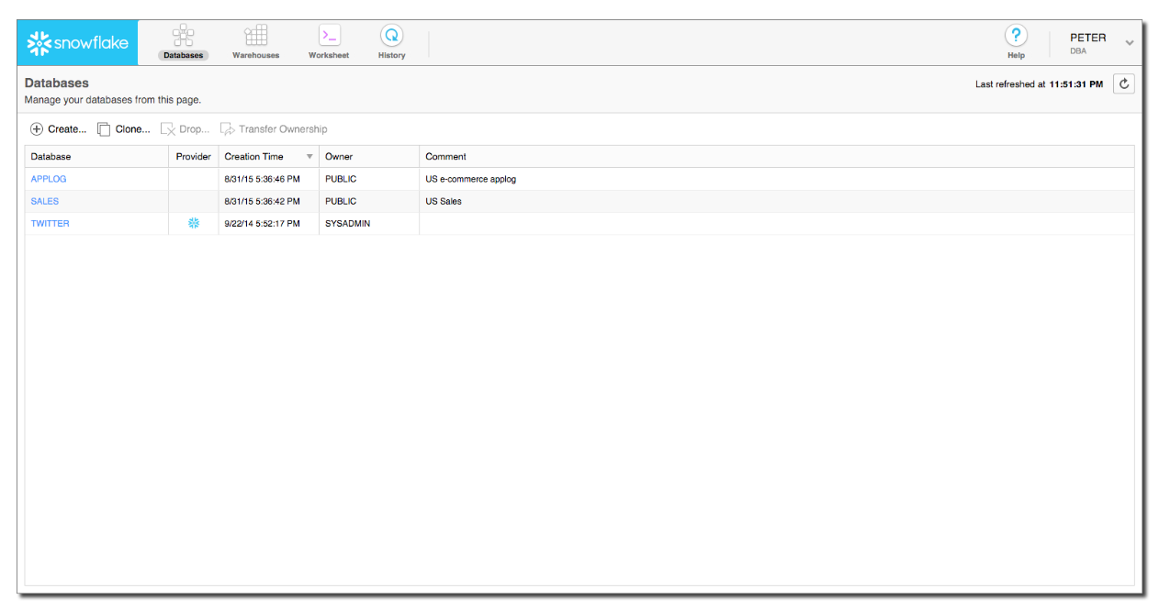
Snowflake on GCP
Snowflake WebUI
WebUI Page Details
Databases Page
Warehouses Page
Worksheet Page
History Page
Help Menu
User Preferences Menu
Databases Page

Slide 19
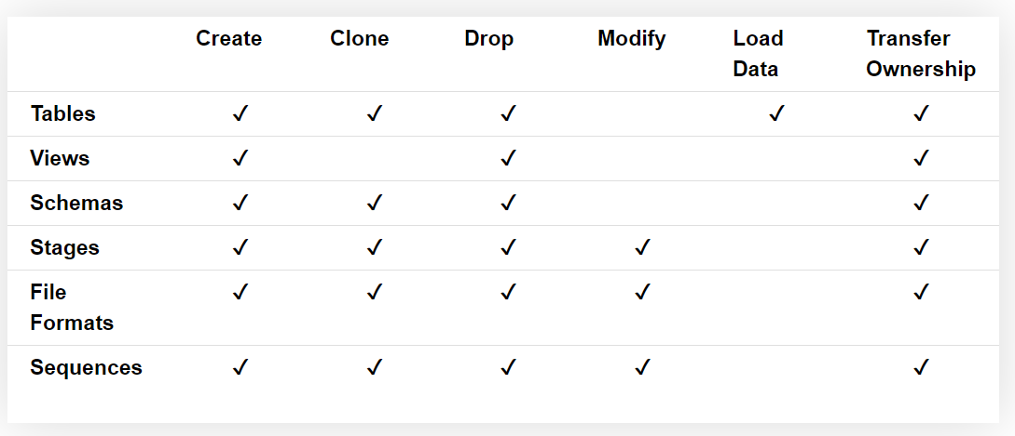
Snowflake on GCP
Snowflake WebUI
Databases Page
Shows information about the Databases that you have created or access to.
You can create , clone ,transfer ownership or drop a database
You can also access or navigate to the below objects in database

Slide 20
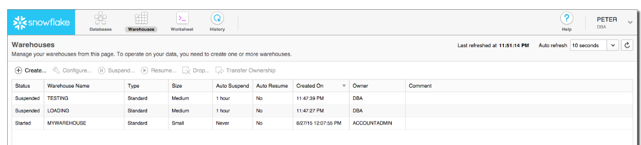
Snowflake on GCP
Snowflake WebUI
Warehouses Page
You can view Virtual Warehouses that you have created or access to
You can do the below actions in Warehouses Page
Create or drop a warehouse.
Suspend or resume a warehouse.
Configure a warehouse.
Transfer ownership of a warehouse to a different role.

Slide 21
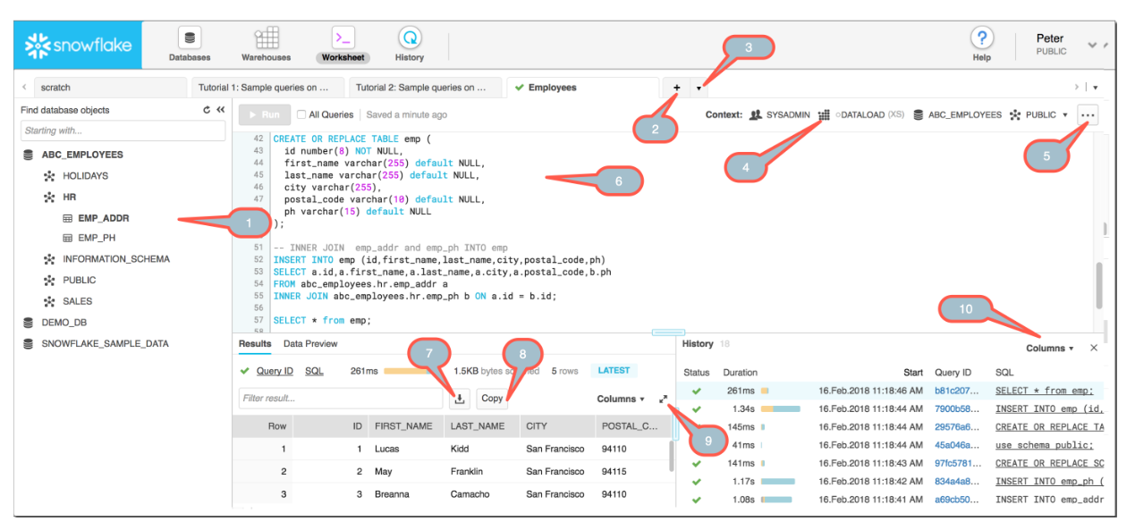
Snowflake on GCP
Snowflake WebUI
Worksheet Page
This page helps us to run our SQLs, Create Procedures, Load Tables.
We can create up to 16 Worksheets and each work sheet can connect to different database with different roles as well
All the worksheets are saved by default and when you connect back the next time to Snowflake all the Worksheets are intact.

Slide 22
Snowflake on GCP
Snowflake WebUI
Worksheet Page – Notes Details
1 – Database Navigator
2 – Create New Worksheet
3 – Open Existing Worksheet
4 – Context Sensitive Menu – Virtual Warehouse
5 – Load a Script, Delete a Worksheet, Highlight Code
6 – Queries or SQL text that can be executed or run
7 – Download the SQL Query Result Set
8 – Copy the SQL Query Result Set
9 – Expand the columns with Result set
10 – Select the columns in the History Details for viewing

